Slide 1



Graphene Oxide for Sensing Applications
Christopher Jabczynski
Mentor: Dr. Anthony Muscat – Chemical Engineering
Lauren Peckler – Chemical Engineering
Date: April 16, 2016
Location: Arizona Space Grant Symposium

Slide 2
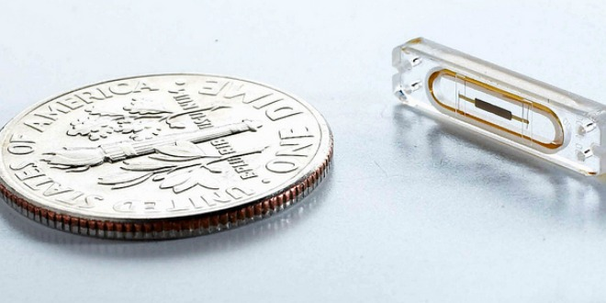
Sensing the world around us…
Determine changes in environment
  Accuracy
  Fidelity
Reliability
  Reproducible results
  Reduced maintenance
The Cardio MEMS wireless sensor. Image: IntelFreePress

Slide 3
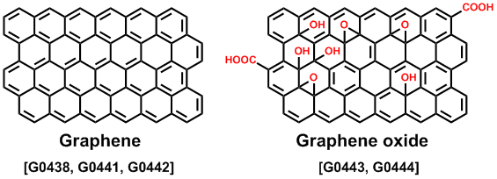
Why Graphene oxide (GO)?
Advantages
  One-atom thick carbon nanosheet
  Graphene is very resilient to Volatile Organic Compounds (VOC)
  GO has greater sensitivity to VOC than Graphene
  GO is feasible for large scale manufacturing
X. Zhang, L. Wang, J. Xin, B. I. Yakobson, F. Ding, J. Am. Chem. Soc. 2014, 136, 3040.

Slide 4
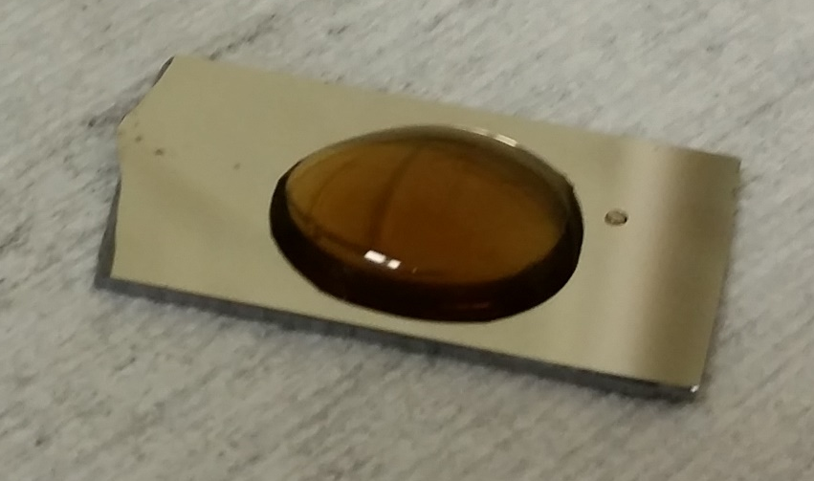
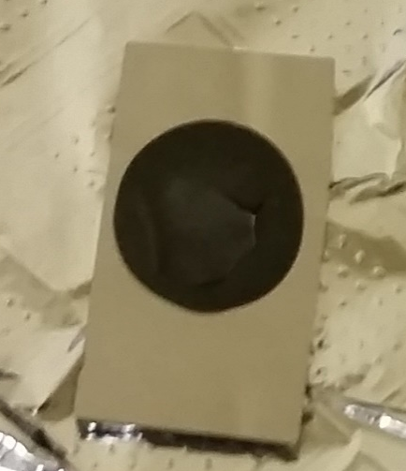
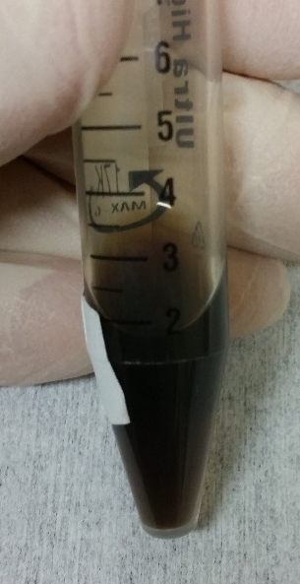
GO Sensor Fabrication
Suspension of Graphene particles was made in solution to create GO
GO was drop cast onto substrate
Dried casting was then annealed
Graphene Oxide Suspension, Muscat Group
G.O. Dropcast on SI substrate, Muscat lab
Annealed G.O. on SI substrate, Muscat lab

Slide 5
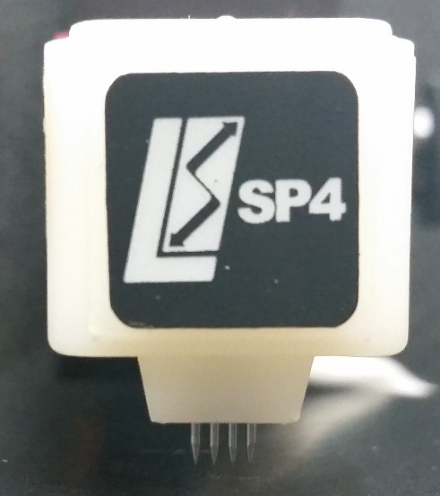
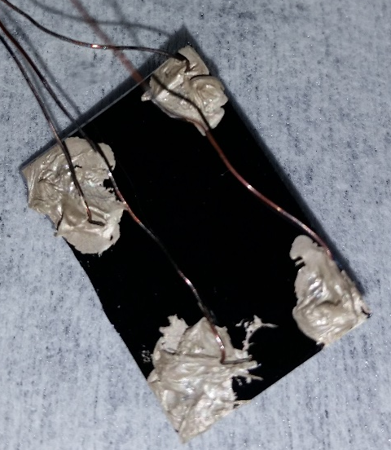
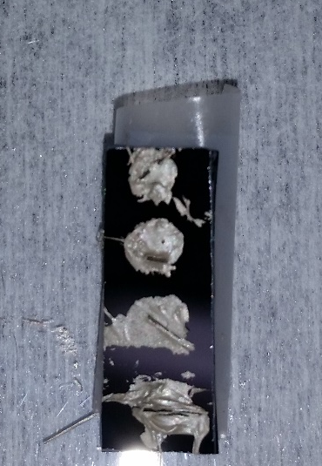
Contacting on the Substrate
Annealed GO was then contacted with silver paste
Corner contacting was used
32 gauge magnetic wire was attached to the silver paste
Four point, and other, contacting was investigated
Corner contacting on G.O., Muscat lab
Four point contacting on G.O., Muscat lab
Four point probe tip from SP4, Muscat lab

Slide 6
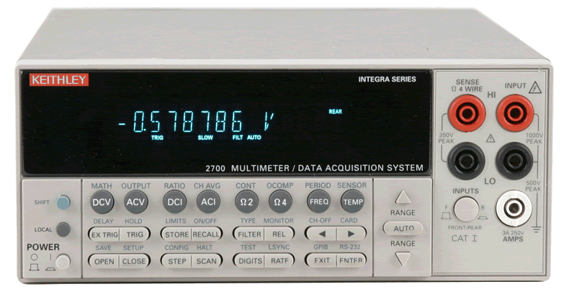
Electrical system setup
Contacted GO was wired to two source meters
The systems was controlled via code written in Labview
Wire was threaded through a stopper in a three neck flask to create a sealed space
Keithly meter - 2700, Tektronik Corp.

Slide 7
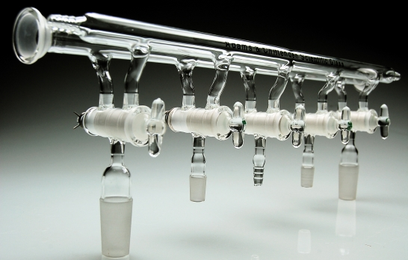
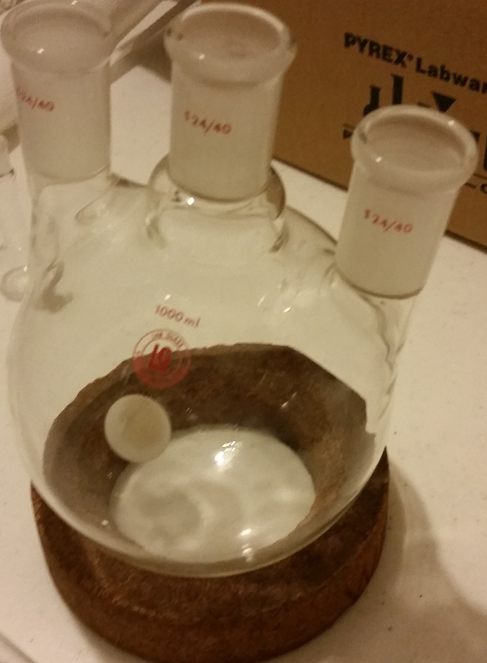
system setup and testing
System was connected to a Schenk line
  Sensor was isolated within the flask
N₂ and CO₂ where used to cycle and purge the system
Schenk line , A.S. Glasware
Three neck flask, Muscat lab

Slide 8
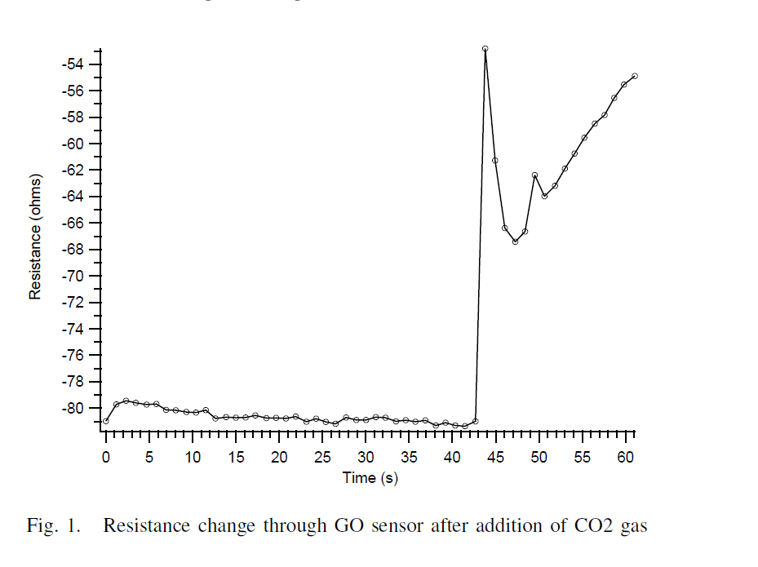
Results - Data
Resistance vs. time
Initial measurement with N₂
CO₂ introduced

Slide 9
Results - Analysis
Sensor baseline at -80 ohms
  Change from inert gas to organic – magnitude difference of 25 ohms
Further cycling of CO₂ and N₂ showed trend toward the baseline

Slide 10
Conclusions
Change in resistance was observed by adding CO₂ to the N₂ purged chamber
Difference in temperature between gasses
  Possible thermal effects

Slide 11
Future Work
Create control sensor without GO
  Investigate thermal effects
Use glass to glass seal instead of rubber stopper

Slide 12
Acknowledgement
NASA Space Grant Consortium
University of Arizona Chemical Engineering Department
Dr. Anthony Muscat
  Muscat group graduate students

Slide 13
Thank you!

